Slide 1
How to set up navx with your computer
With your resident expert, john Dunaske ( ͡° ͜ʖ ͡°)

Slide 2
What is navx?
Navx-MXP, or just navx, is a nice RoboRIO expansion board. It’s a 9 – axis sensor, and expands the RoboRIO with an extra 10 digital I/O’s, 4 analog inputs, 2 analog outputs, and TTL UART, I2C, and SPI ports. The sensors include, a gyroscope, an accelerometer, a magnetometer, and a compass.

Slide 3
Setup(Program)
First you want to talk to me, as I have the setup software on a flash drive.
Then, run the software on your computer (Hint: its called ‘setup’!)

Slide 4
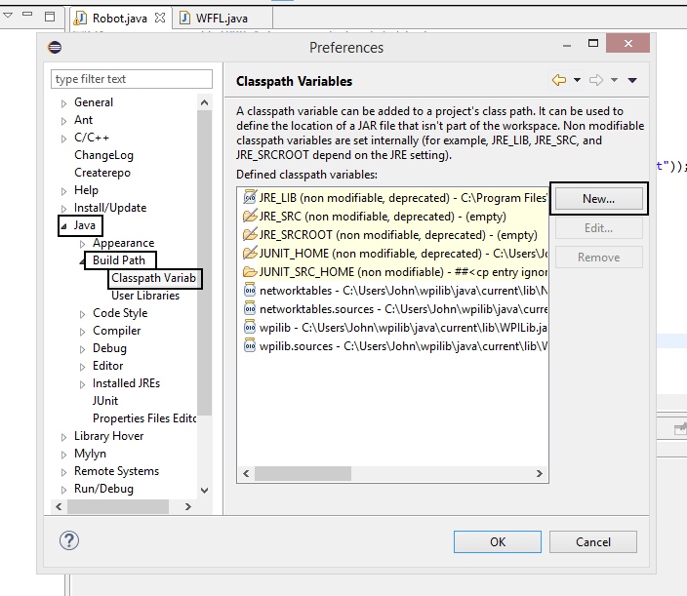
Setup (Classpath variables)
Now you need to create a
classpath variable for the Navx.
Go to: Window>Preferences>
Java>Build Path>Classpath Variables

Slide 5
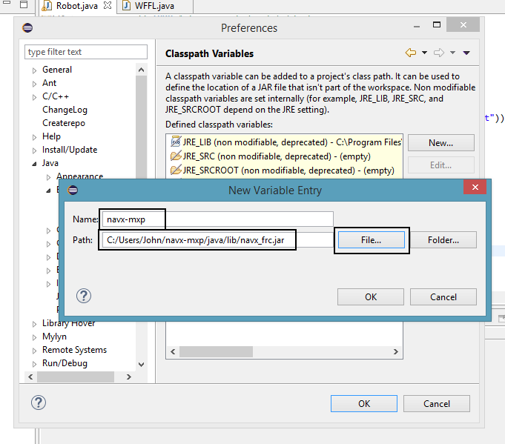
Setup (Classpath variables, cont.)
Now you need to actually
create the variable
Name it ‘navx-mxp’ and then click ‘File’
and find the path to ‘navx_frc.jar’
(Hint: Should be the same for everyone!)

Slide 6
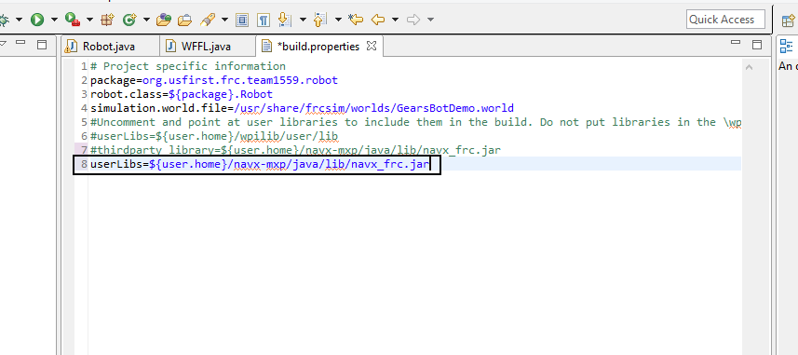
Setup (Build.properties)
You now need to add the
navx as a third party library.
Add this line →

Slide 7
You’re almost done!
One more step, this is probably the longest one.

Slide 8
Editing the build.Properties
I know you’re probably like “Johhhnnnn, I already did this, why are you making me do it again?”. Well it’s the build.properties of wpilib, and they need to be edited to be able to use the navx.

Slide 9
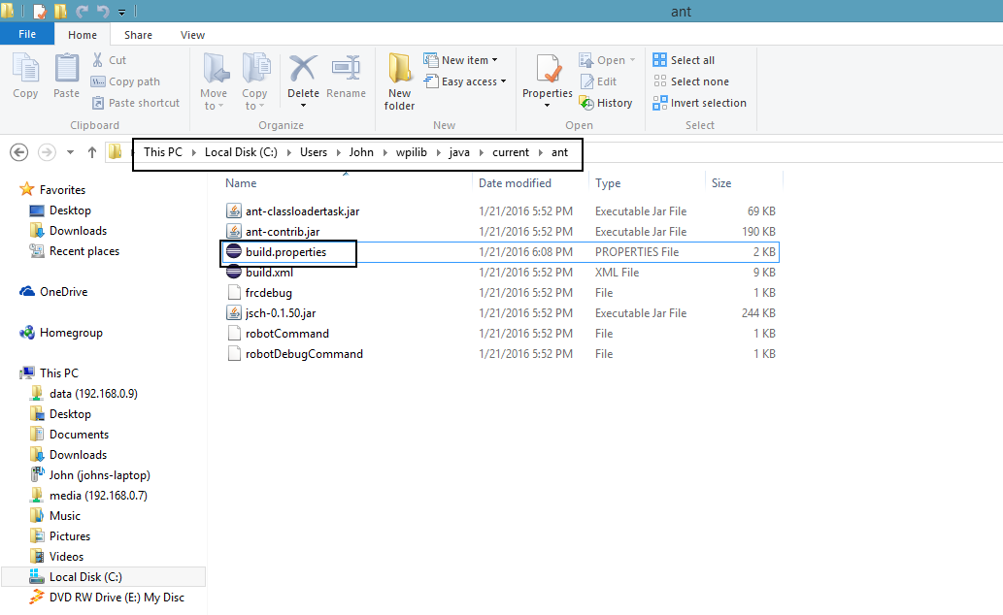
Editing the build.properties
First, you need to get to
the wpilib build.properties.
The path is the same for
everyone, and I recommend
opening the file in eclipse or
sublime text (if you have it).

Slide 10
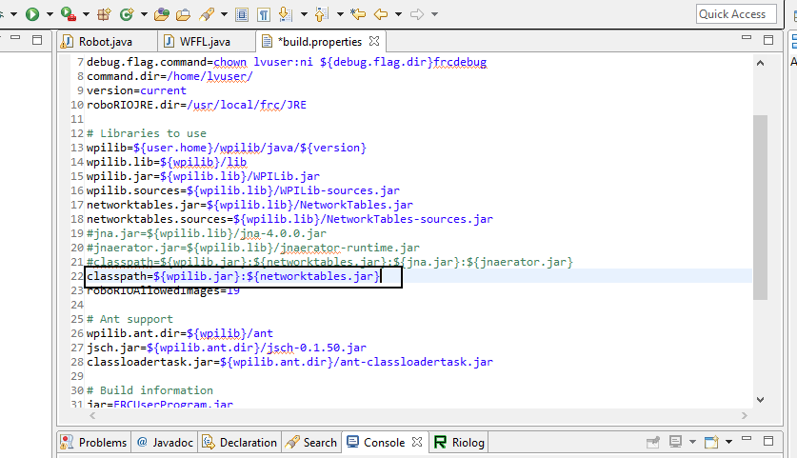
Editing the build.properties (cont.)
When you open the
file in your preferred program,
you will see this line →
You will need to change this line
in the next step.

Slide 11
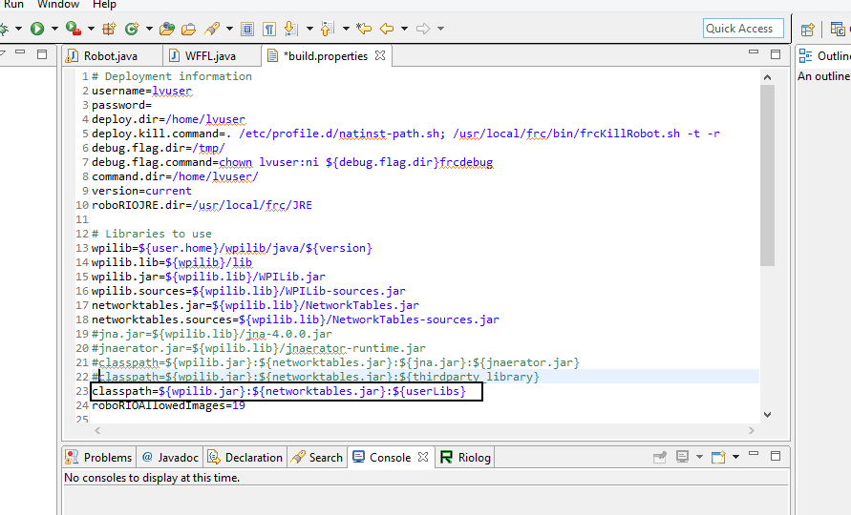
Editing the build.properties (cont.)
You need to type in the
following line →
This allows it to import
the navx.

Slide 12
Conclusion
You have finished the setup! Good job!
If you want to learn how to code using the navx, talk to me or look at the documentation on your own time. Trust me it’s not that hard.

